Slide 1
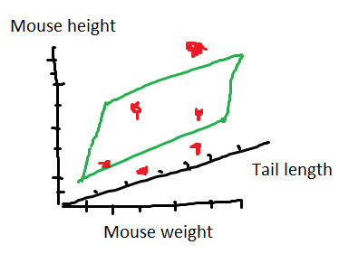
Multiple linear regression
Is just like simple regression but you fit a higherdimensional object to your data. With this you can predict a dependent variable with multiple independent variables.

